Slide 1

Lower Bounds

Slide 2

Lower bounds in computer science refer to the minimum computational resources required to solve a particular problem or perform a specific computation.
They help establish limits on what can be achieved in terms of time, space, or other resources when solving a problem,

Slide 3
Types of Lower Bounds:
Time Complexity Lower Bounds: These bounds focus on the minimum number of steps or operations needed to solve a problem. For instance, proving that a sorting algorithm requires at least O(nlogn) comparisons to sort n elements establishes a time complexity lower bound.
Space Complexity Lower Bounds: These bounds concern the minimum amount of memory or space required to solve a problem. Establishing that a problem requires a certain amount of space to solve, irrespective of the algorithm used, provides a space complexity lower bound.

Slide 4
The Decision Tree method
There are many methods are there for Establishing Lower Bounds
One among them is Decision tree method
It is a powerful technique used in computer science, specifically in computational complexity theory, to establish lower bounds on the worst-case running time of algorithms.
Here we construct decision trees to model the computational process and establishing lower bounds based on the depth of these trees.

Slide 5
Understanding Decision Trees:
Modeling Computations: Decision trees are a way to model the computation of an algorithm in a tree-like structure, where each internal node represents a decision based on an input parameter, and each leaf node represents the algorithm's output or decision.
Path in the Tree: For any input instance, the algorithm's behavior is represented by a path from the root to a leaf in the decision tree. Each internal node corresponds to a decision made based on some part of the input.
Leaf Nodes and Outputs: The leaf reached by an input instance determines the algorithm's output for that particular input.

Slide 6

Lower Bounds for Comparison based Sort

Slide 7
To understand the concept of lower bounds for comparison-based sorting using a simple example with three elements: a, b, and c.
There are 3!=6 possible permutations:
. (a1, a2, a3), (a1, a3, a2), (a2, a1, a3), (a2, a3, a1) ,(a3, a1, a2), (a3, a2, a1)
The Comparison based algorithm defines a decision tree.

Slide 8
Decision Tree Model:
To find the lower bound, let's construct a decision tree that represents the comparisons needed to correctly sort all possible permutations.
At each level of the tree, a comparison between two elements is made based on the outcome of the comparison.
Each path from the root to a leaf represents a sequence of comparisons that leads to a sorted arrangement.

Slide 9
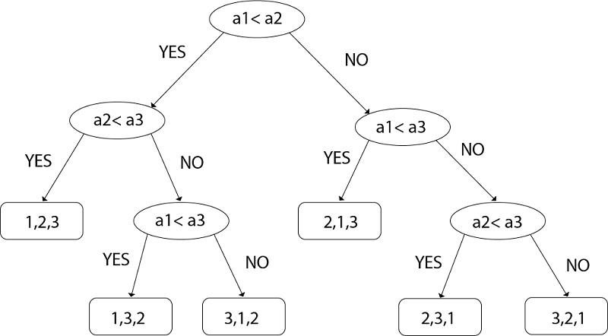
taking an Example of comparing a1, a2, and a3.
Left subtree will be true condition i.e. a_{i} ≤ a_{j}
Right subtree will be false condition i.e. a_{i} >a_{j}

Slide 10
For n=3 elements, the number of leaf nodes in the decision tree (3!) represents the minimum number of distinct outcomes needed to correctly distinguish all permutations.
This implies a minimum of 3!comparisons are required in the worst-case scenario to sort these three elements.
The general lower bound for sorting n elements using comparison-based algorithms is O(nlogn),

Slide 11

Comparison based Searching

Slide 12
comparison-based searching refers to searching for an element in a data structure, typically an array or a list, using comparisons between elements to determine equality or ordering.
Types of Comparison-Based Searches:
Binary Search: A classic comparison-based search algorithm that works on sorted arrays by repeatedly dividing the search interval in half.
Ternary Search: Similar to binary search but divides the array into three parts instead of two.
Exponential Search: An algorithm that involves doubling the search interval size until finding a range where the target element might reside and then performing a binary search within that range.

Slide 13
Comparison-based searching algorithms are fundamental and widely used due to their efficiency in sorted structures.

Slide 14
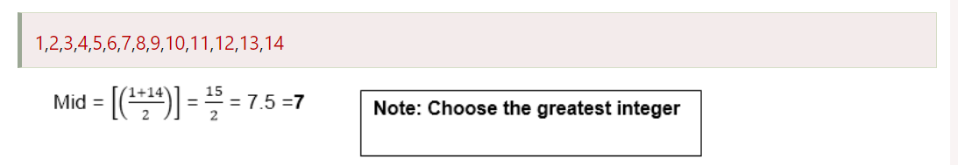
Comparison tree for Binary Search
Suppose we have a list of items according to the following Position:

Slide 15
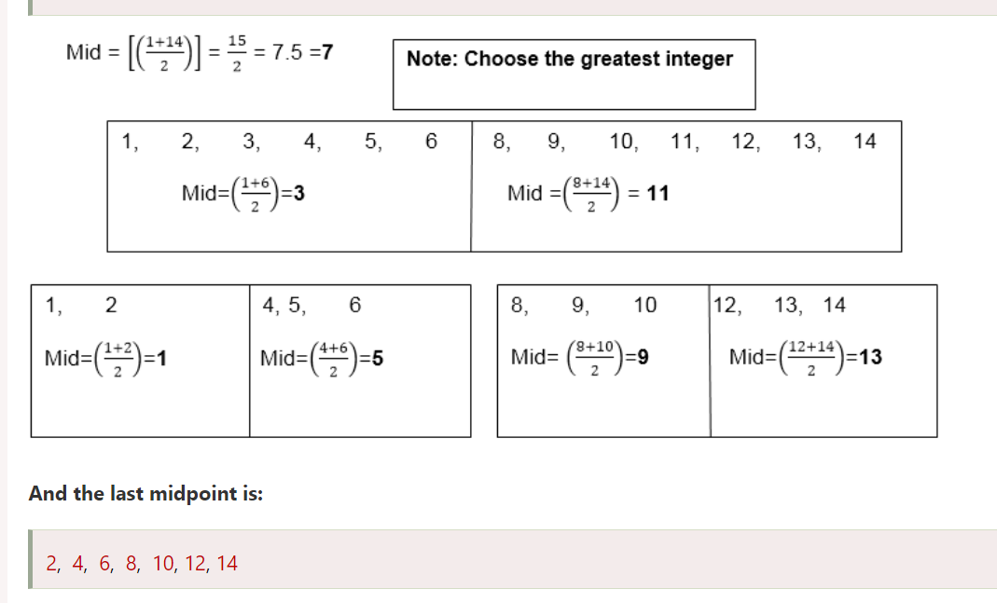

Slide 16
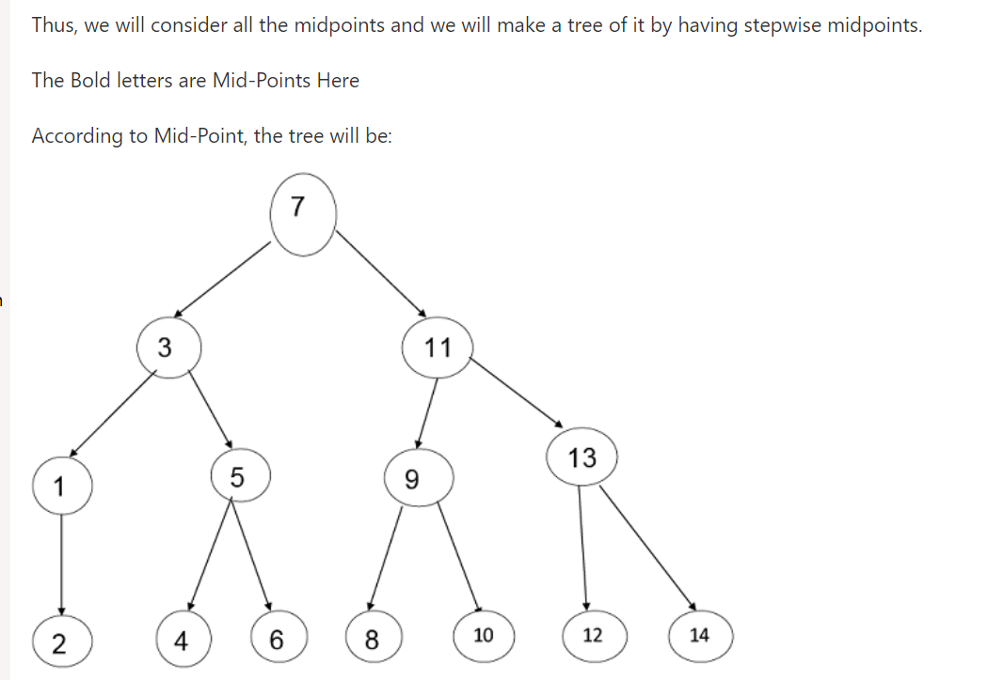
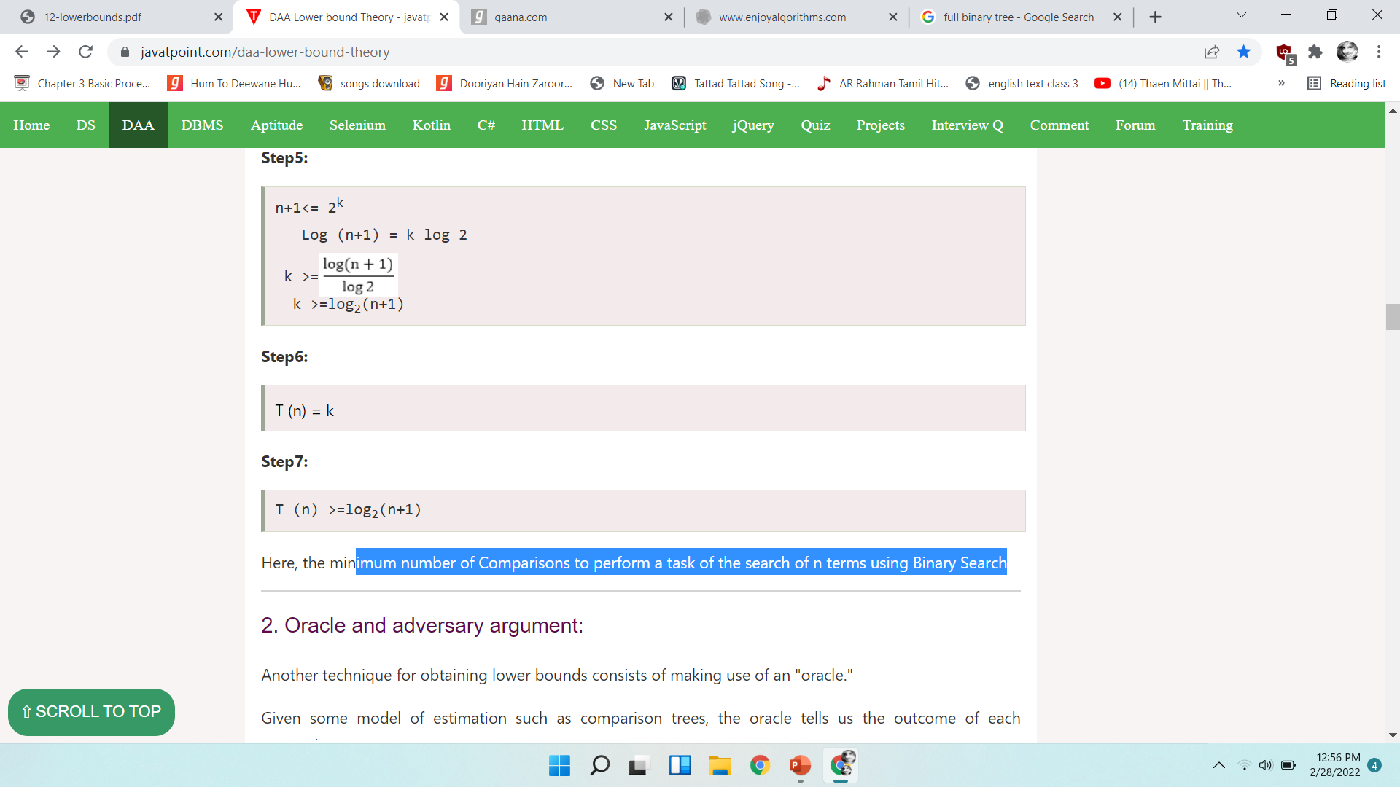
minimum number of Comparisons to perform a task of the search of n terms using Binary Search

